Slide 1



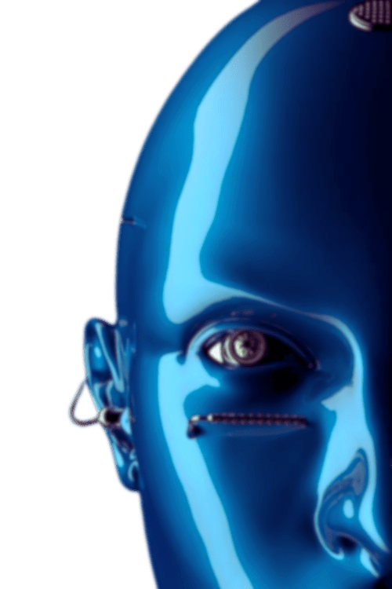

K.A.M.A.L.A
Kapidhwaj Association of Modern logic, Automation, Learning and career Advancement
PROBLEM STATEMENT
(HEADING)
Your Proposed Solution (Sub heading)
PRESENTED BY:
PRESENTED TO:
Malhar shamkant ugale
Ai Agents Workshop - Mini Hackathon
Kapidhwaj Innovations Pvt Ltd

Slide 2
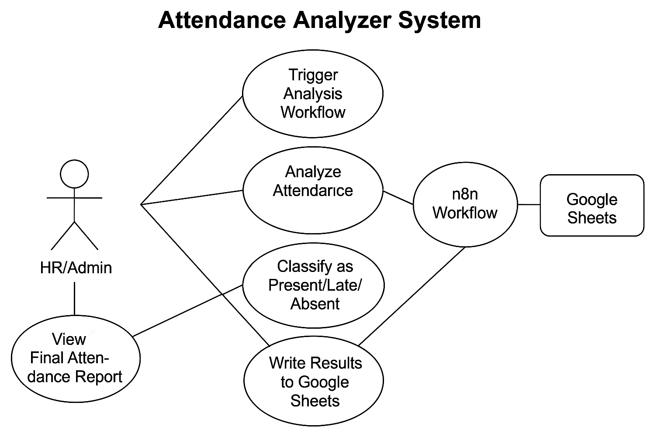
K.A.M.A.L.A
Kapidhwaj Association of Modern logic, Automation, Learning and career Advancement
WORKFLOW DIAGRAM

Slide 3
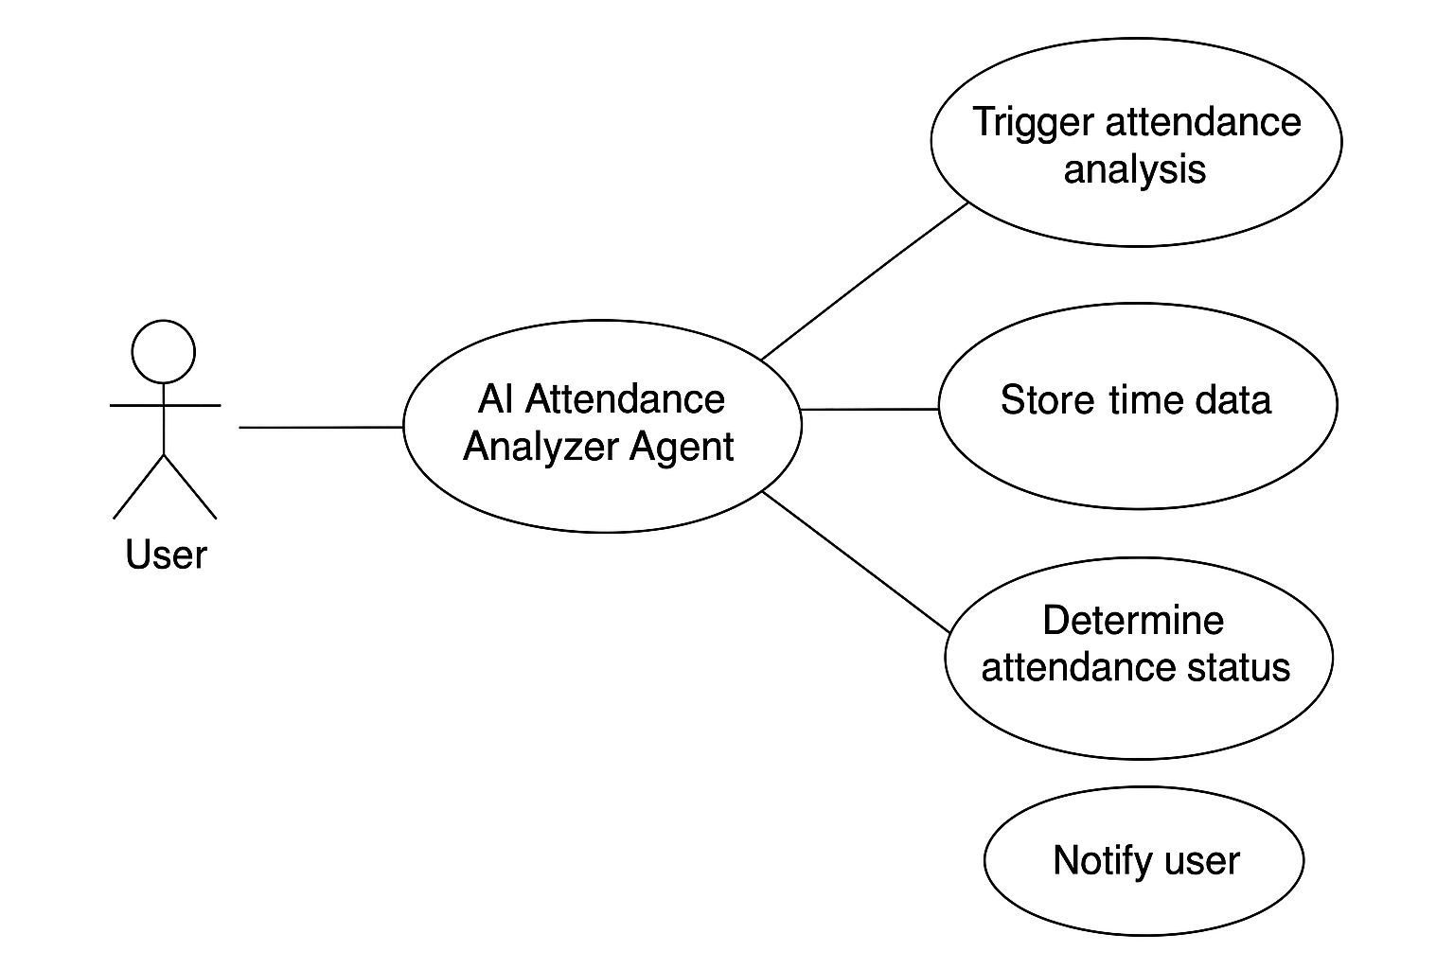
K.A.M.A.L.A
Kapidhwaj Association of Modern logic, Automation, Learning and career Advancement
USE CASE

Slide 4
K.A.M.A.L.A
Kapidhwaj Association of Modern logic, Automation, Learning and career Advancement
ADVANTAGES
No More Manual Data Checking
Automatically classifies each person as Present, Late, or Absent — no need to scroll through clock-in times.
Clean, Structured Summary
Writes directly into a Summary tab in Google Sheets — easy for reporting, payroll, or review.
3.Customizable Logic
You control the definition of “Late” (e.g., 9:30 AM). Need to change it to 9:45 later? One edit.
Scalable
Whether you have 3 students or 300 employees — the workflow handles everyone equally.
Integrates with Anything
Since it’s built in n8n, you can add triggers from:
Emails
Slack messages
QR check-ins
Google Forms
Auditable History
Your Summary sheet keeps a clean timestamped record — useful for tracking behavior patterns or generating monthly reports.

Slide 5
K.A.M.A.L.A
Kapidhwaj Association of Modern logic, Automation, Learning and career Advancement
FUTURE SCOPE
Integration with Biometric/QR Code Systems
Directly sync with biometric devices or QR code scanners for real-time check-in/check-out data.
Mobile App Integration
Provide a mobile interface for employees to view their attendance history, apply for leave, or correct errors
.
AI-Driven Insights & Predictions
Use ML models to identify attendance patterns, predict future absenteeism, and suggest actions to HR.
Smart Notifications & Alerts
Auto-email or message employees if they’re late, absent frequently, or have irregular patterns.
Leave & Shift Management Module
Manage leaves, shift rotations, and official holidays seamlessly within the same system.
NLP Chatbot for HR Queries
Implement a chatbot for employees to ask about their attendance, leaves, or raise disputes.
Integration with HRMS / Payroll Systems
Sync attendance data with payroll to automate salary calculations and deductions.

